Slide 1
CSC435: Web Programming Lecture 7: CSS/HTML review, Exercises
Bei Xiao
American University
Feb 8, Friday, 2019

Slide 2
Activity Outline
Review of HTML
Review of CSS Box model, positioning
Exercise 1: Journal layout. Require turn in on blackboard.
Reading about page layout: http://www.webstepbook.com/samples/ch04-layout.pdf

Slide 3
HTML = Contents
Headings
Paragraphs
Lists
Links
Logs
Informative foreground images
Tables

Slide 4
Not Content
Columns and position
Alignment
Colors/Fonts
List bullets
Decorations
Background images
…and more

Slide 5
Content = tags
Headings = <h1>……<h6>
Paragraphs = <p>
Lists = <ul>
Links = <a>
Logos = <img>
…and more

Slide 6
Writing HTML5 markup simply means deciding:
What is the semantic relationship between contents?
<nav>, <section>, <figure>
E.g. <section> defines a section of a document such as chapters, headers. It is a semantic element.
What is a hierarchical relationship between contents?
Choose heading contact tags and nest them.
What kind of content? Choose flow and phrase tags> <h>, <p>, <blockquote>, <ul>, <img> and so on

Slide 7
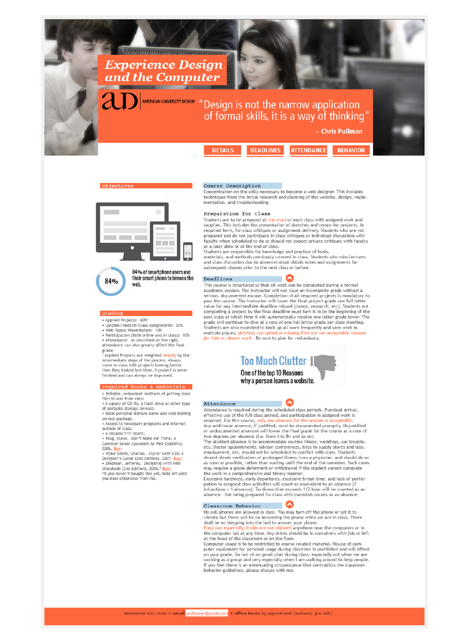
Slide credit: Yana Sakellion

Slide 8
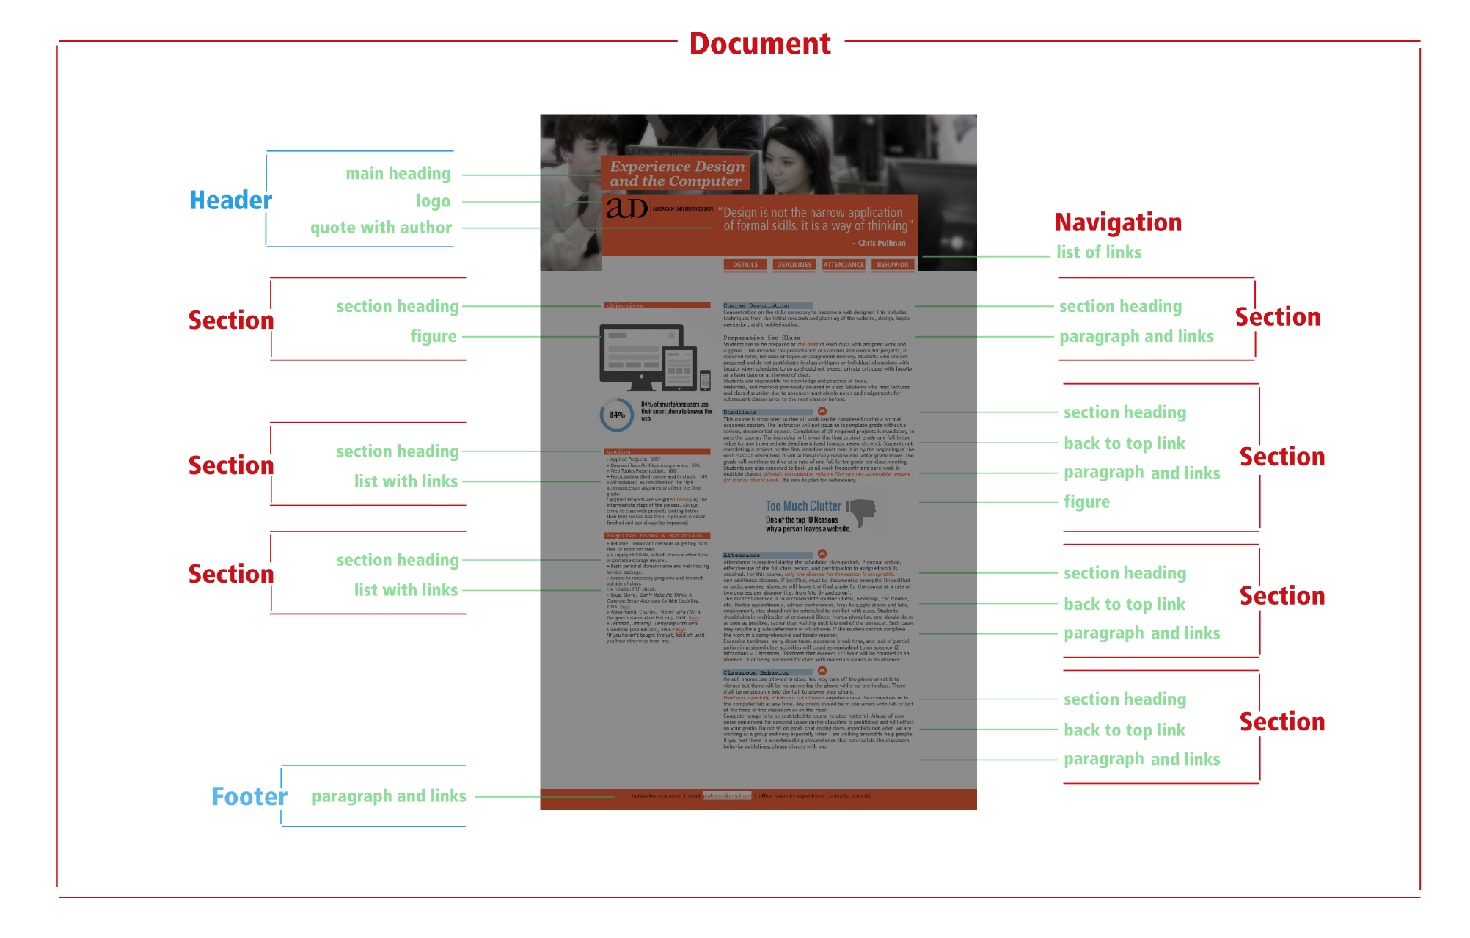
Slide credit: Yana Sakellion

Slide 9
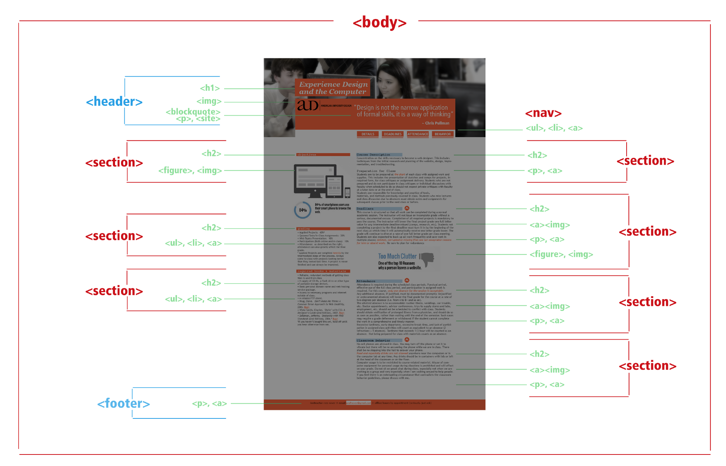
Slide credit: Yana Sakellion
Notes:
<section> tag defines sections in a document, such as chapters, headers, footers,
Or any other sections of the document.

Slide 10
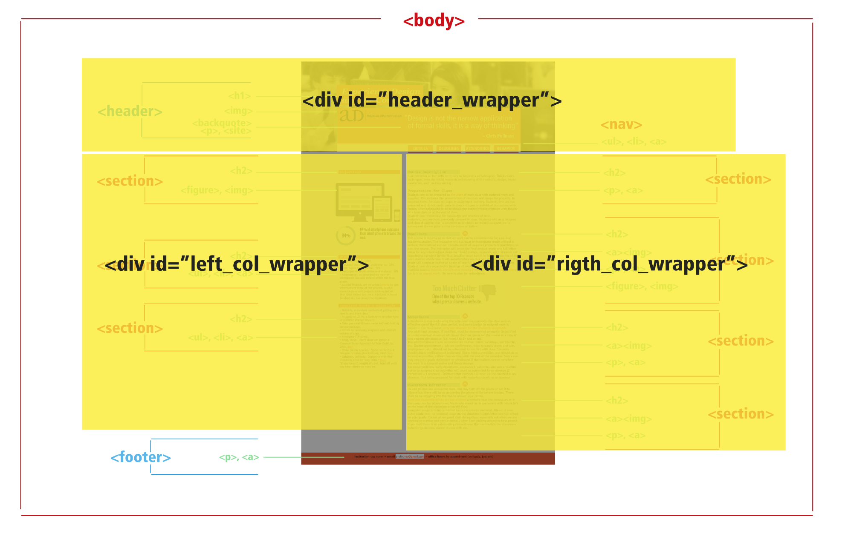
Slide credit: Yana Sakellion

Slide 11
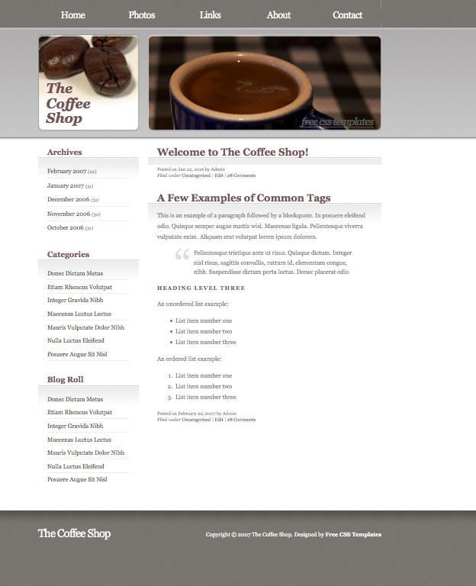
Write down semantic relationship of the page.
Then write down the corresponding elements tags.
Finally, have a plan to how to divide the page into divs

Slide 12
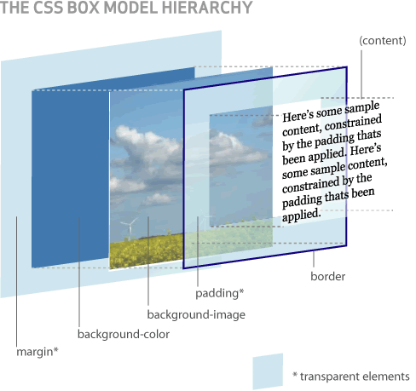

Slide 13
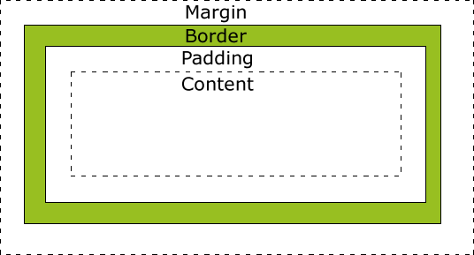
Use Margins to space block element
TOTAL WIDTH IN PX = CONTENT WIDTH + PADDING + BORDER + MARGINS

Slide 14
CSS positioning
Static (default)
Fixed
Absolute
Relative

Slide 15
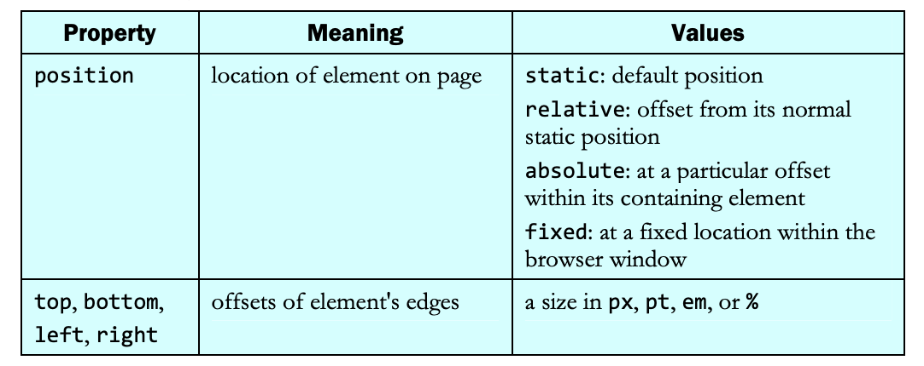
CSS positioning

Slide 16
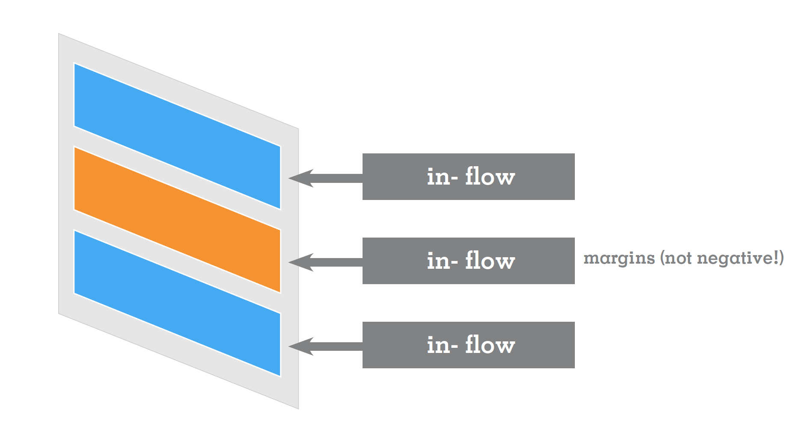
1. Static (default)
Slide credit: Yana Sakellion

Slide 17
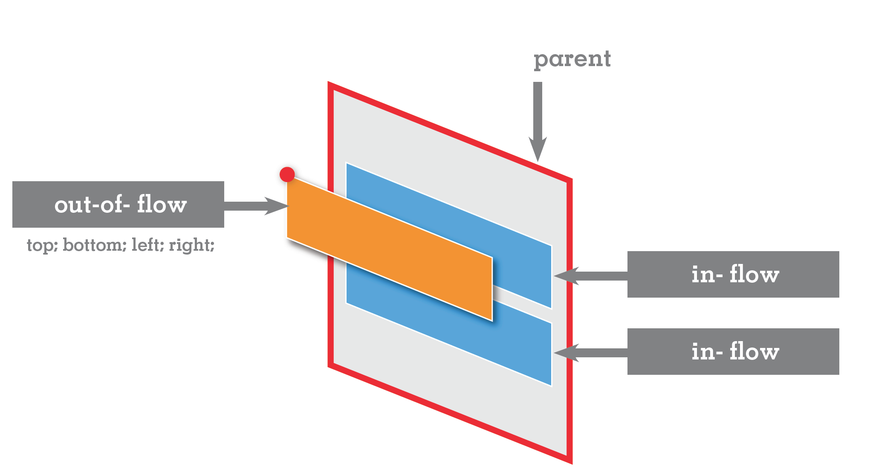
2. Fixed position
Browser window !
Slide credit: Yana Sakellion

Slide 18
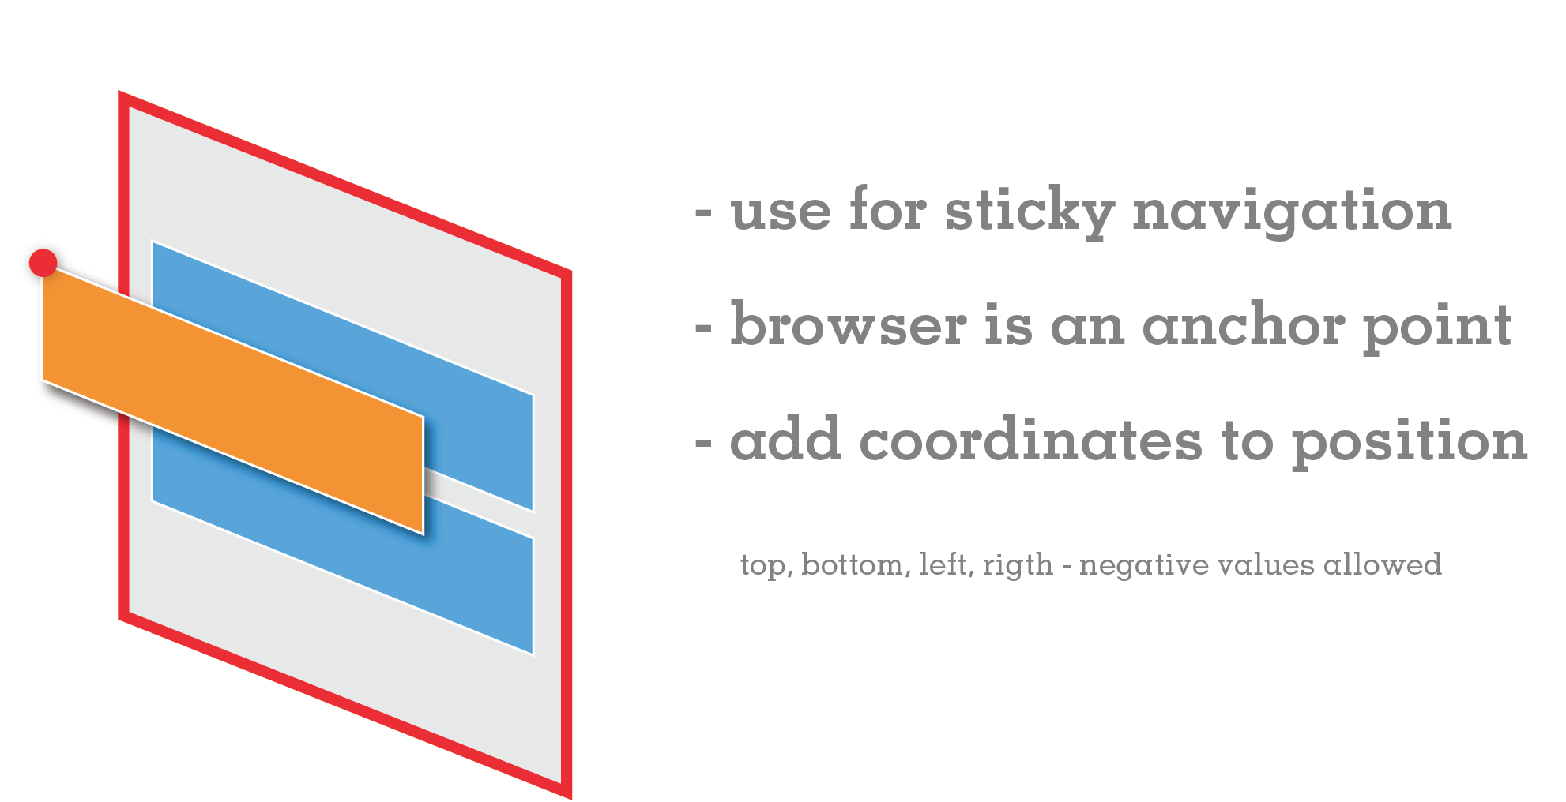
2. Fixed position do not scroll
Sticky navigation Example: https://niice.co/
Slide credit: Yana Sakellion

Slide 19
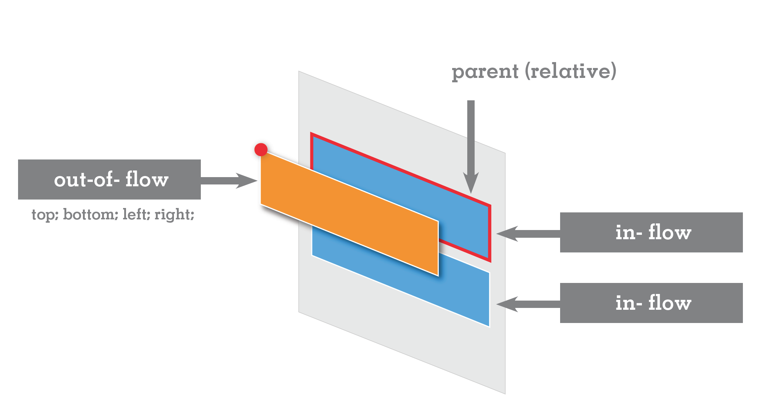
3. Absolute Position
Slide credit: Yana Sakellion
Notes:
absolute: at a particular offset within its containing element

Slide 20
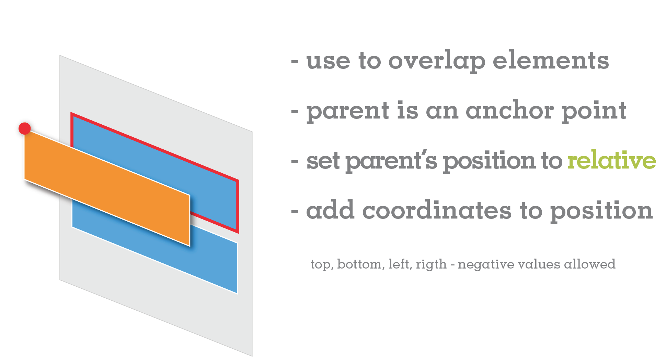
3. Absolute Position
If absolute positioned element has no positioned ancestors, it uses document body.
Slide credit: Yana Sakellion
Notes:
An element with position: absolute; is positioned relative to the nearest positioned ancestor (instead of positioned relative to the viewport, like fixed).
However; if an absolute positioned element has no positioned ancestors, it uses the document body, and moves along with page scrolling.

Slide 21
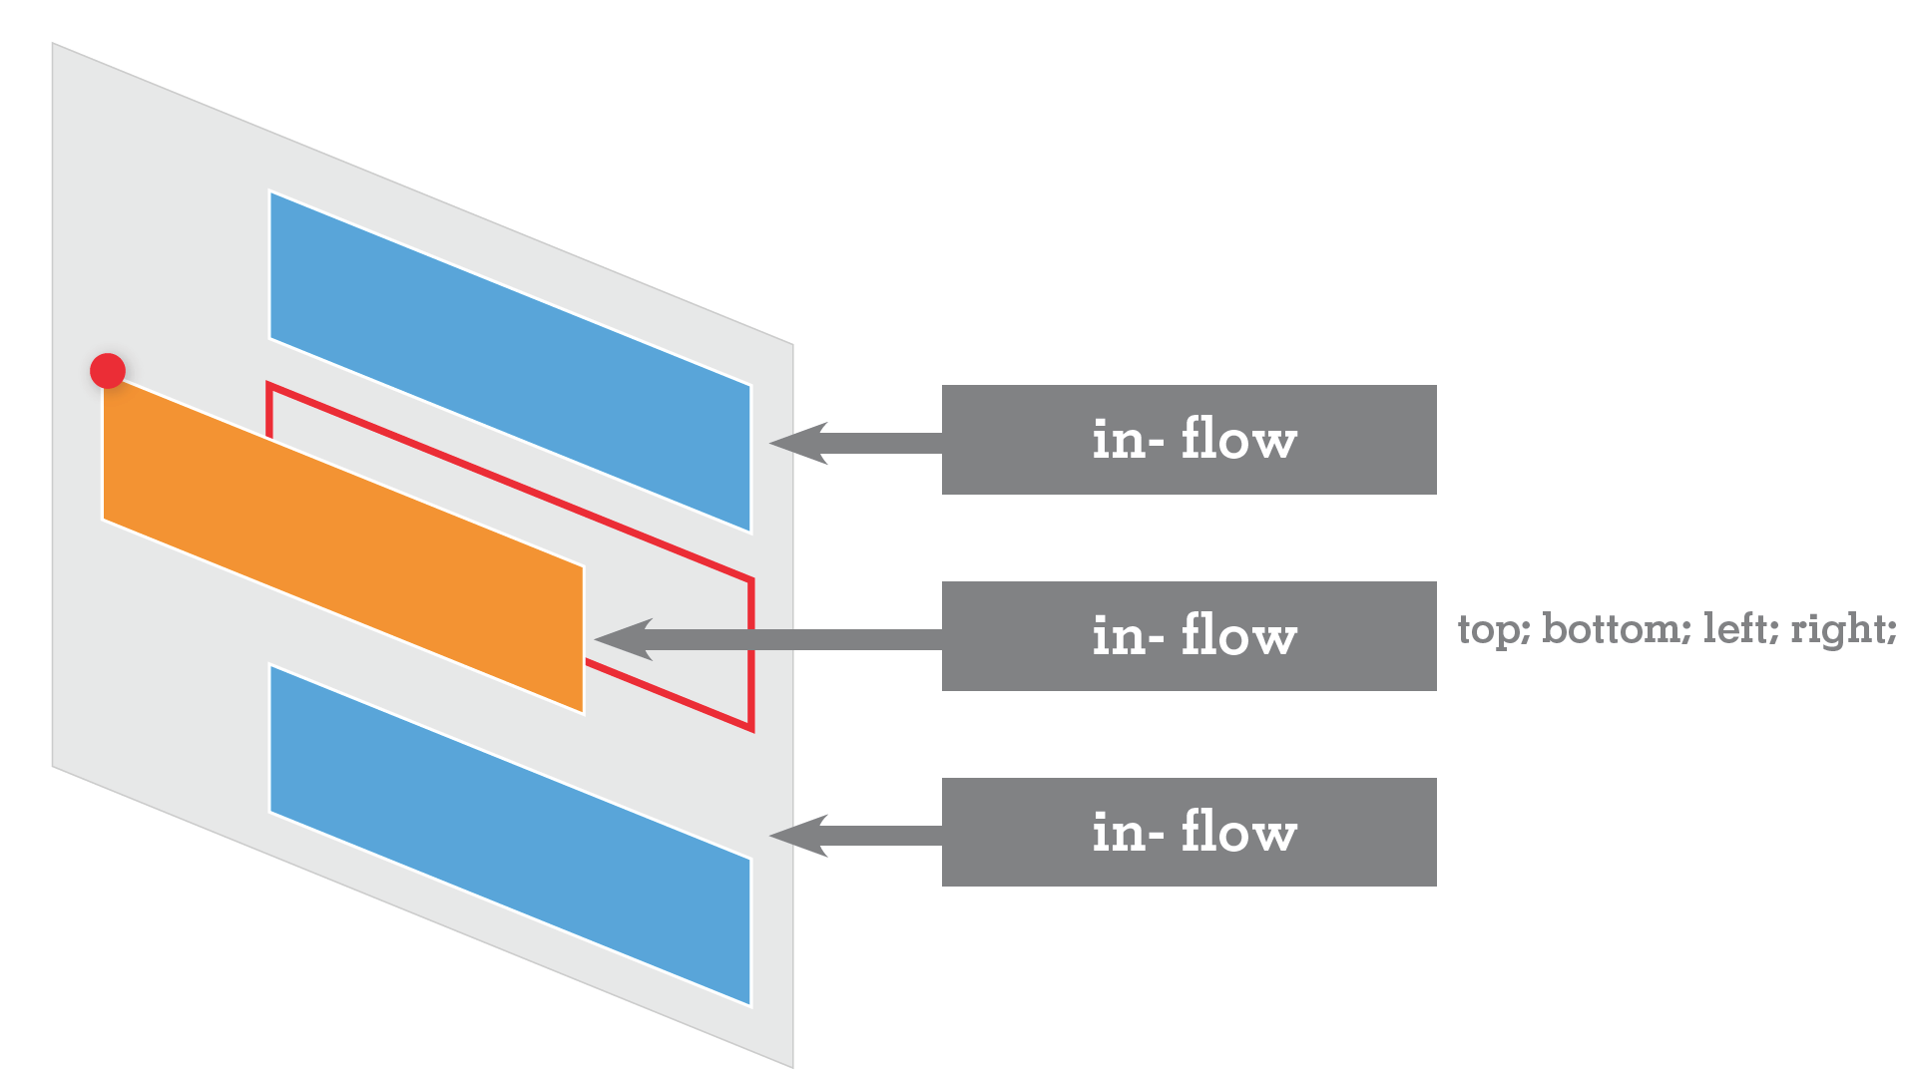
4. Relative Position
Slide credit: Yana Sakellion
Notes:
to instead cause the absolute element to position itself relative to some other element's corner, wrap the absolute element in an element whose position is relative

Slide 22
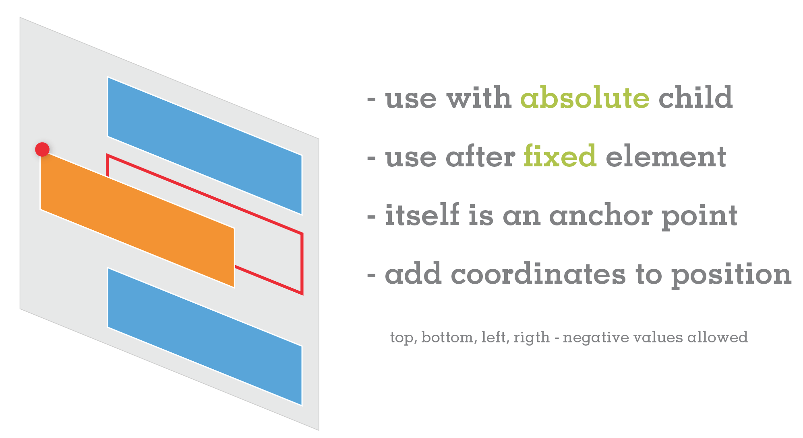
4. Relative Position
Slide credit: Yana Sakellion
Notes:
Relative to its normal position.

Slide 23
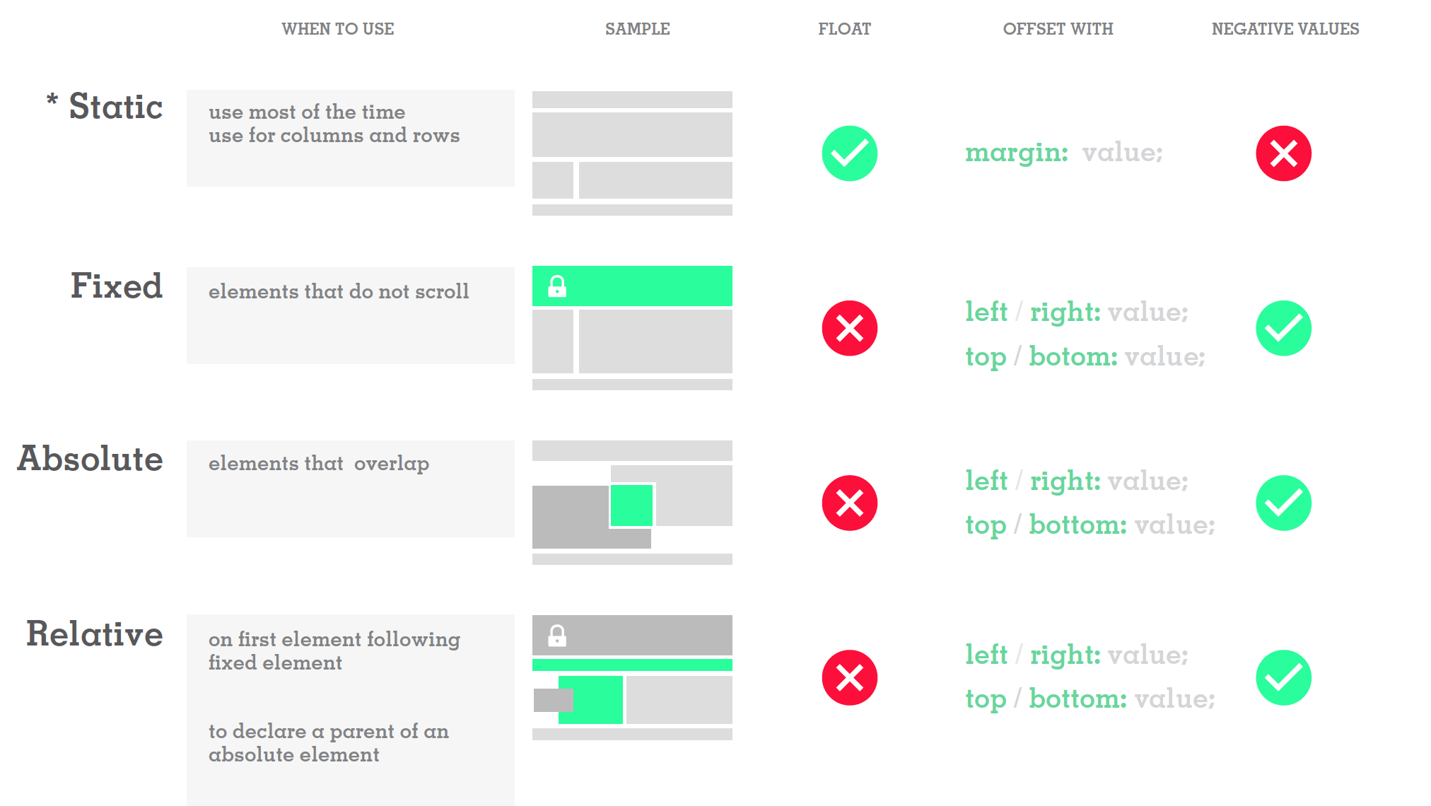
CSS position summary
Slide credit: Yana Sakellion

Slide 24
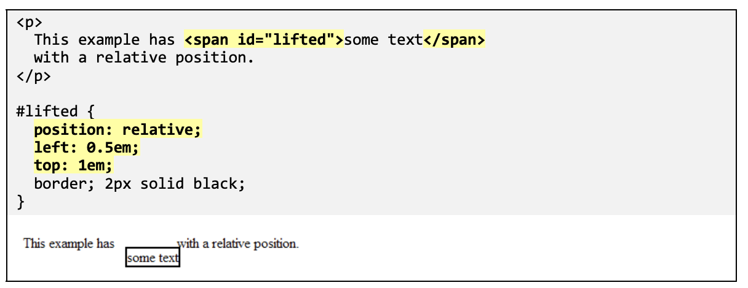
Relative Positioning
Relative positioning: shift an element's position slightly relative to its normal static position.

Slide 25
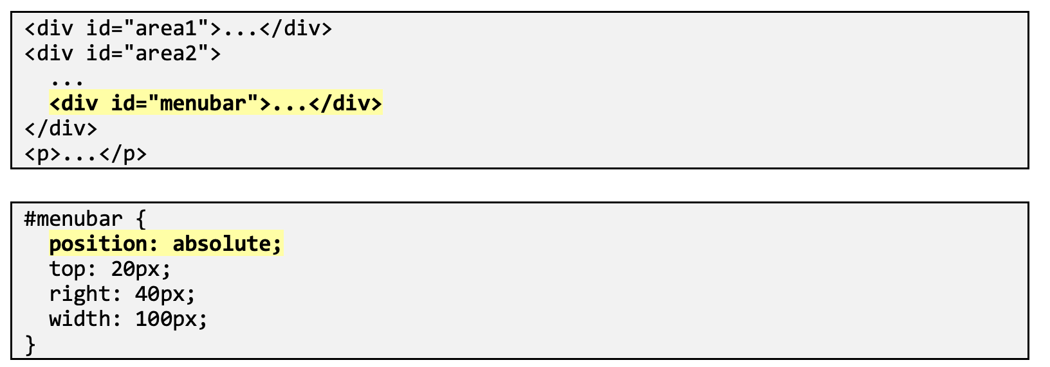
Absolute Positioning

Slide 26
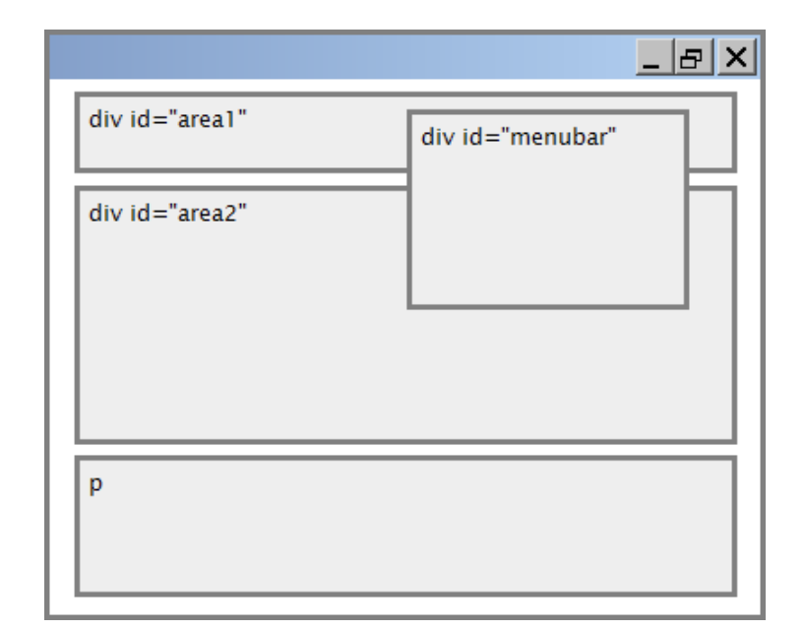
Absolute Positioning
Generally the coordinates of an absolutely positioned element are relative to the entire page.

Slide 27
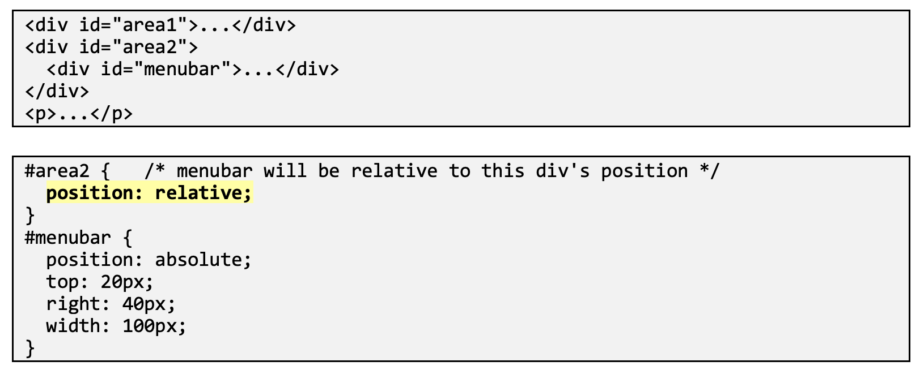
Absolute Positioning

Slide 28
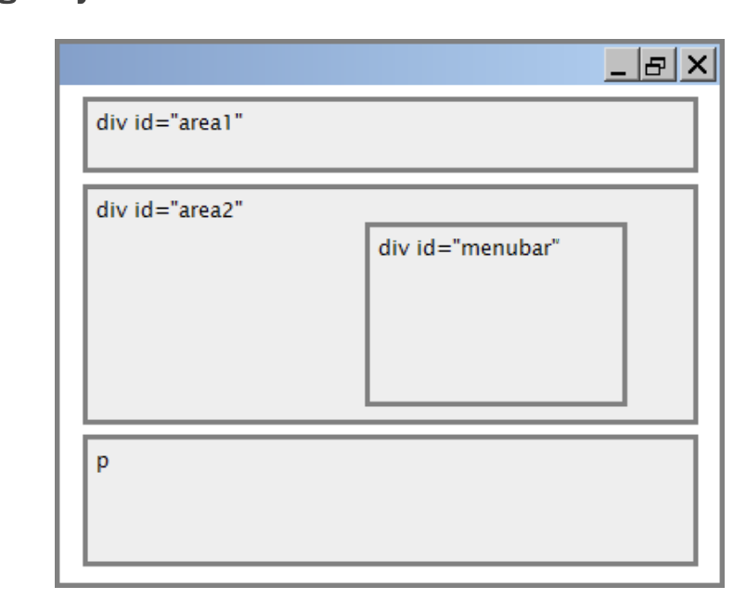
Absolute Positioning

Slide 29
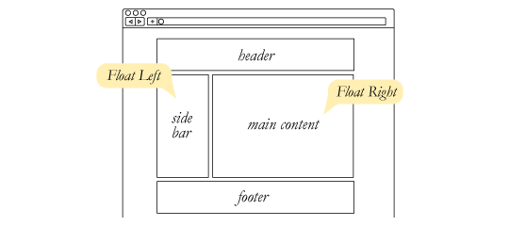
Float can be used for multicolumn layout
https://css-tricks.com/almanac/properties/f/float/

Slide 30
Multi-column layouts
<div>
<p>the first paragraph</p>
<p>the second paragraph</p>
<p>the third paragraph</p>
Some other text that is important
</div>
p { float: right; width: 20%; margin: 0.5em;
border: 2px solid black; }
div { border: 3px dotted green; overflow: hidden; } CSS
Some other text that is important
the third paragraph
the second paragraph
the first paragraph

Slide 31
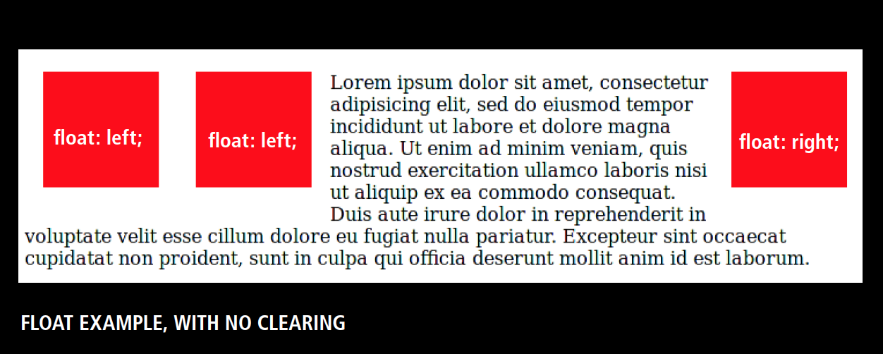
Float properties
takes elements out of the document flow and positions them next to each other (and other content) in specified direction.
https://css-tricks.com/almanac/properties/f/float/

Slide 32
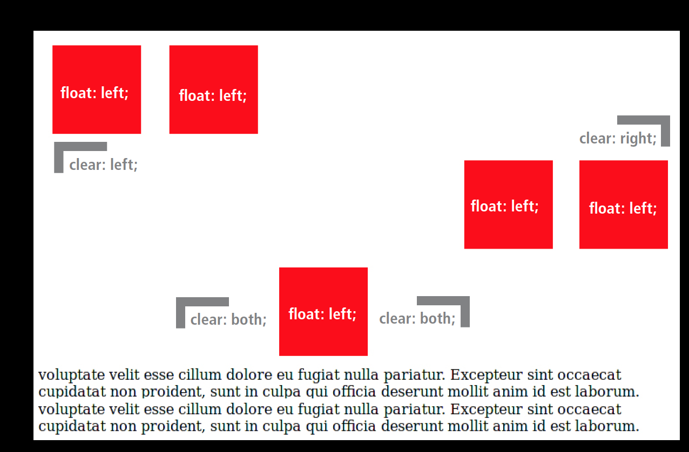
Clear properties
Is used to create breaks before and/or after elements in a specified direction

Slide 33
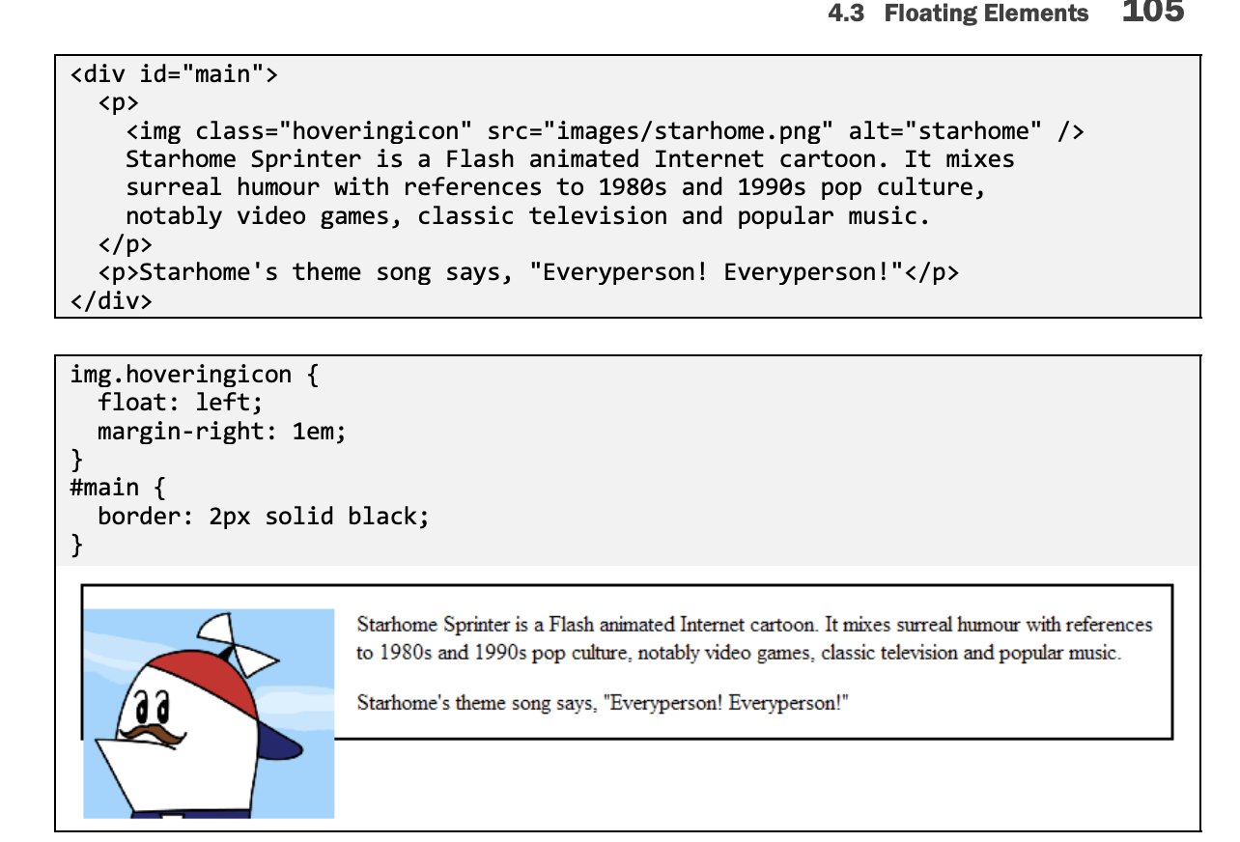
How to make float element fit

Slide 34
How to make float element fit
Property | Values | Values
Overflow | action to take if element's content is larger than the element itself | visible (default), hidden, scroll, auto

Slide 35
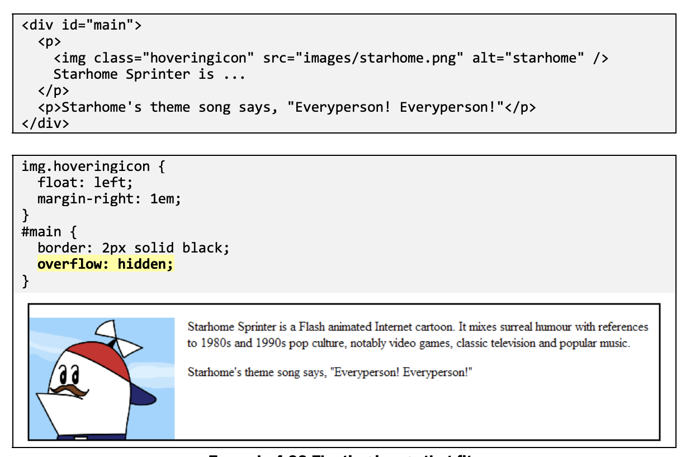
How to make float element fit

Slide 36
Display property
Inline
block
None
Flex

Slide 37
Display property
h2 { display: inline; background-color: yellow; } CSS
output
This is a heading
This is another heading
property | description
display | sets the type of CSS box model an element is displayed with
values: none, inline, block, flex
use sparingly, because it can radically alter the page layout

Slide 38
Displaying block elements as inline
<ul id="topmenu">
<li>Item 1</li>
<li>Item 2</li>
<li>Item 3</li>
</ul> HTML
#topmenu li {
display: inline;
border: 2px solid gray;
margin-right: 1em;
} CSS
output
Item 1
Item 2
Item 3
lists and other block elements can be displayed inline
flow left-to-right on same line
width is determined by content (block elements are 100% of page width)

Slide 39
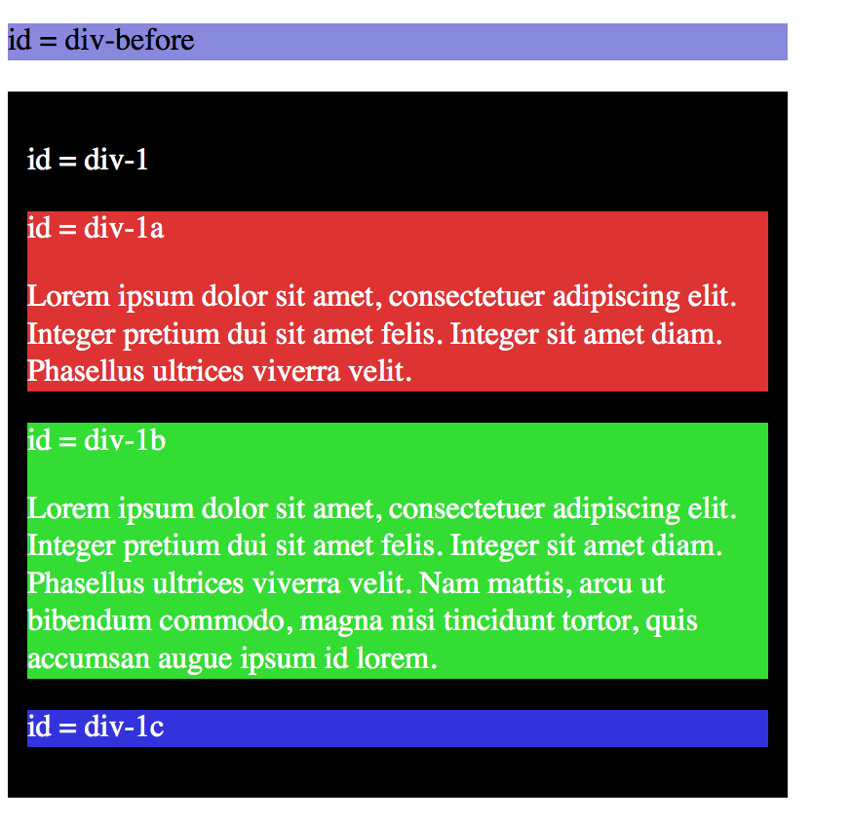
Positioning: static
Default position for all element. You don’t have to specify this unless
you want to override a position
previously set.
#div-1 {
position:static;}

Slide 40
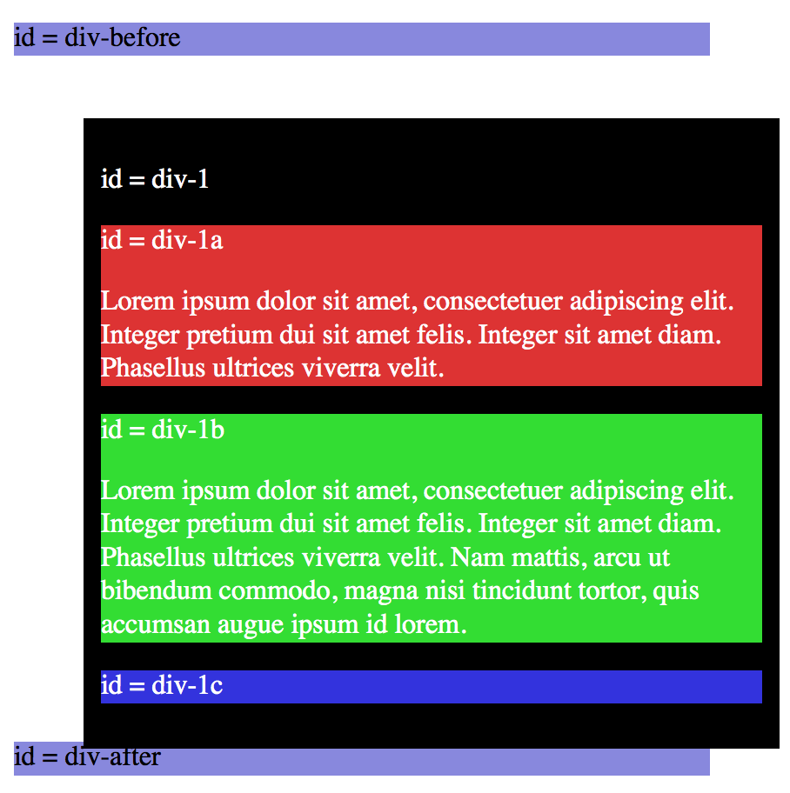
Positioning: relative
Relative position means relative
to the element where it would normally
occur. You can specify top,
bottom, left or right.
#div-1 {
position: relative;
top:20px;
right:-40px;}
Notes:
Notice that div-after didn’t move.

Slide 41
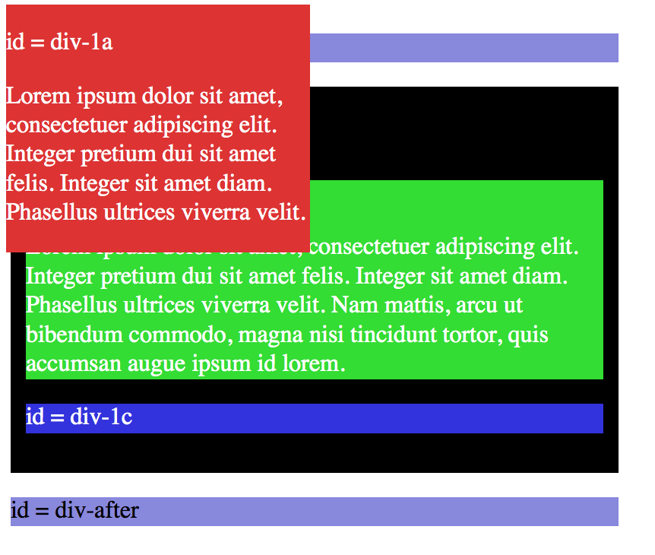
Positioning: absolute
the element is removed form
the document and placed exactly
where you tell it to go.
#div-1a {
position:absolute;
top:5;
left:5px;
width:200px;
}
Notes:
Notice that div-after didn’t move.

Slide 42
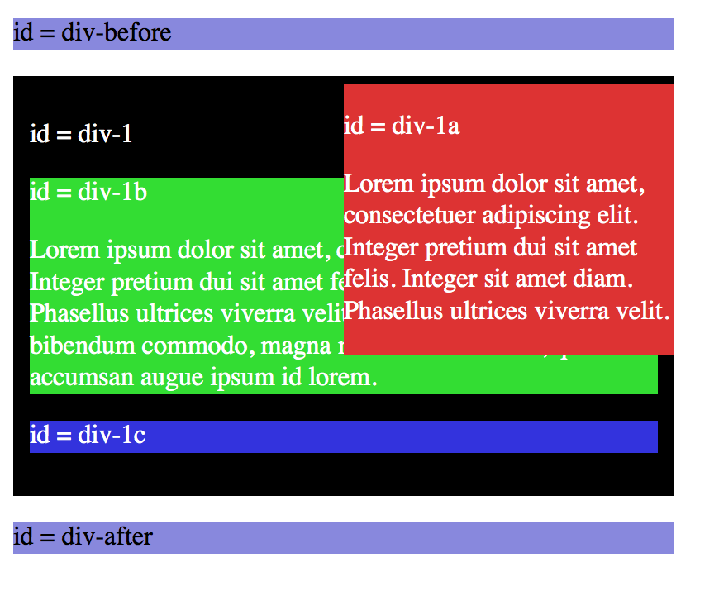
Positioning: relative + position: absolute
If we set relative positioning on div-1,
Any elements within div-1 will be positioned
relative to div-1. Here we move div-1a to top
of div-1:
#div-1{
position:relative;}
#div_1a{
position:absolute;
top:0
right:0
width:200px;
}
Notes:
Notice that div-after didn’t move.

Slide 43
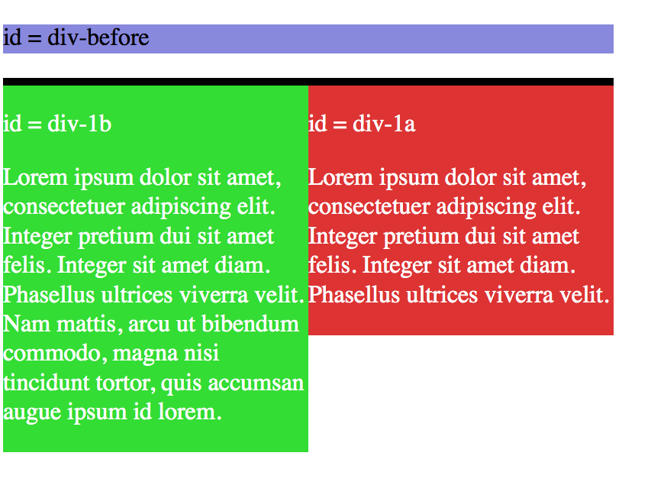
Positioning: two columns layout
How do we make the page has two columns using position relative and absolute?
Please modify div-1, div-1a and div-1b to make the page appear:
Notes:
Notice that div-after didn’t move.

Slide 44
Positioning: two columns layout
How do we make the page has two columns using position relative and absolute?
Please modify div-1, div-1a and div-1b to make the page appear:
#div-1{
position:relative;}
#div_1a{
position:absolute;
top:0
right:0
width:200px;
}
#div_1b{
position:absolute;
top:0
left:0
width:200px;
}
Notes:
Notice that div-after didn’t move.

Slide 45
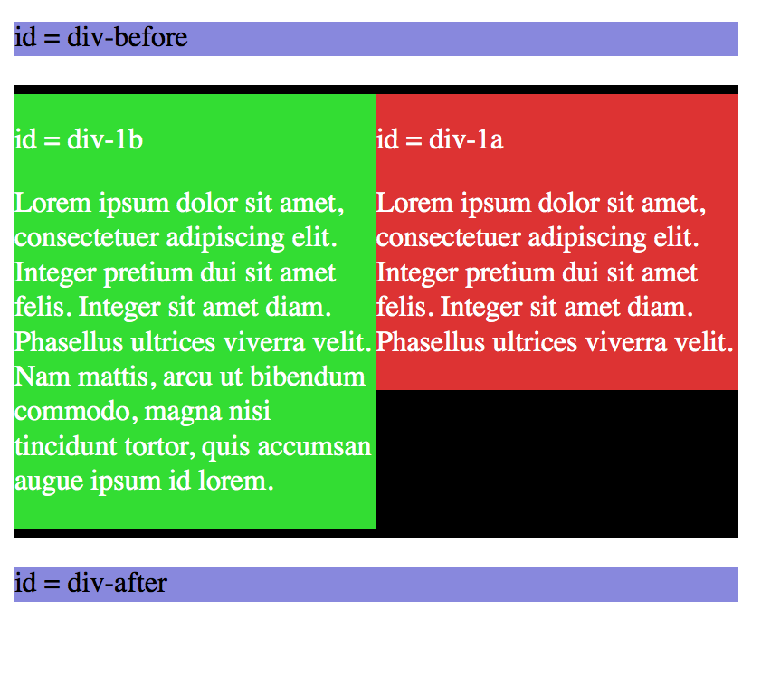
Positioning: two columns layout
Two columns that have absolute height
#div-1{
position:relative;
height: 250px}
#div_1a{
position:absolute;
top:0
right:0
width:200px;
}
#div_1b{
position:absolute;
top:0
left:0
width:200px;
}
Notes:
Notice that div-after didn’t move.

Slide 46
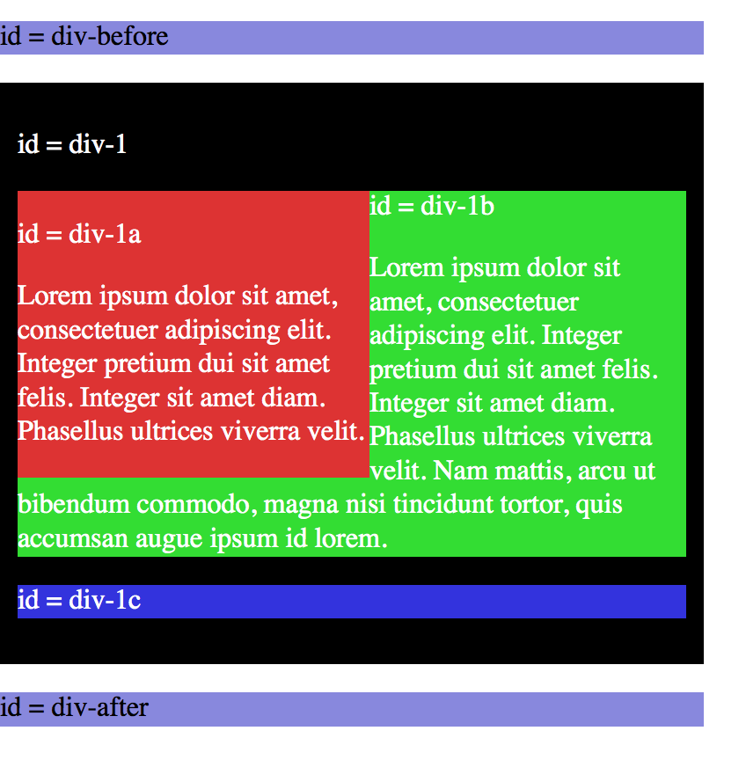
This can also be easily achieved by float but notice text will wrap around
#div-1{
position:relative;}
#div_1a{
float:left
}
#div_1b{
}
Notes:
Notice that div-after didn’t move.

Slide 47
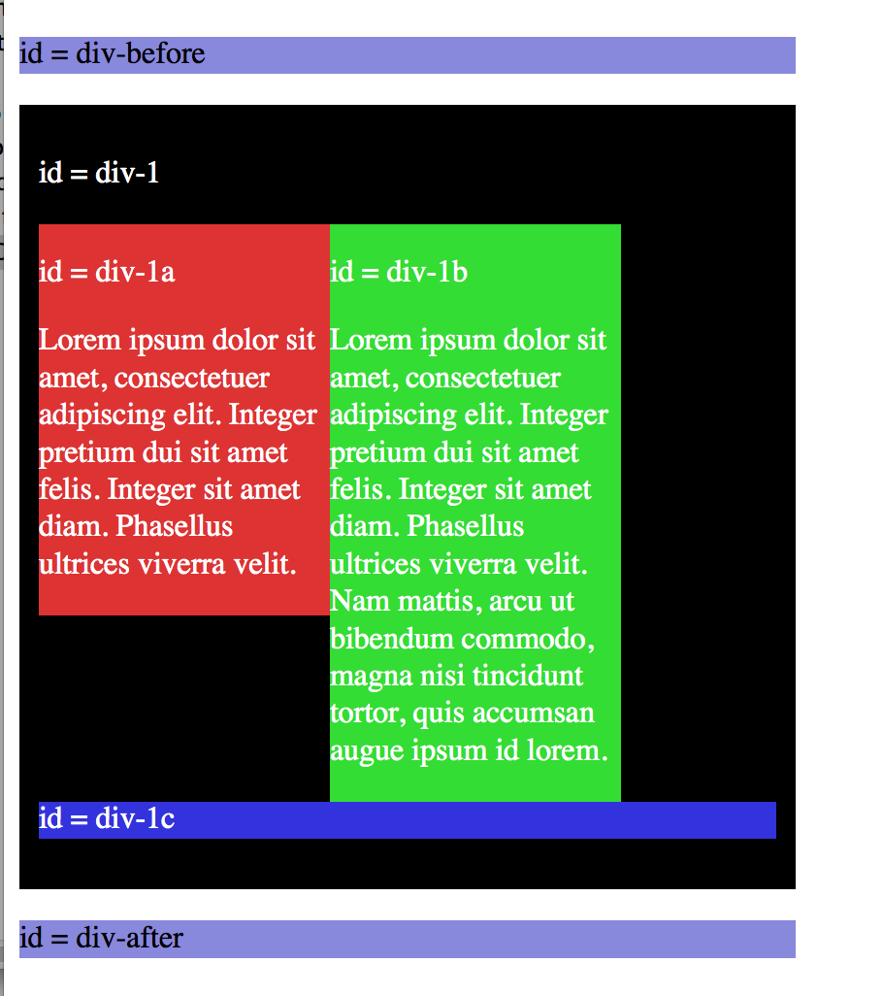
How to achieve this? Use clear
Notes:
Notice that div-after didn’t move.

Slide 48
How to achieve this? Use clear
#div-1{
position:relative;}
#div_1a{
float:left;
width:190px
}
#div_1b{
float:left
width:190px
}
#div_1c{
clear:both:
}
Notes:
Notice that div-after didn’t move.

Slide 49
Flexbox
Useful for aligning block level content into various layouts.
Flexbox can help manage how the elements should be sized next to each other.
Like the position property, you have to think about your content in terms of elements themselves, and the contents they are in.

Slide 50
Basic properties for the flex container
display: flex;
makes an element a “flex container”, items inside automatically becomes “flex items”.
justify-content: flex-end; (flex-start, space-around…)
indicates how to space the items inside the container along the main axis.
align-items: flex-end; (flex-start, center, baseline).
indicates how to space the items inside the container cross axis.
flex-direction: row; (column).
indicates whether the container flows horizontally or vertically.

Slide 51
Read more on Flexbox
Complete guide to flexbox
https://css-tricks.com/snippets/css/a-guide-to-flexbox/

Slide 52
How to layout a page
First try box model, text-align, vertical-align
Next try flex boxes. Powerful way to build many different layouts in a page.
Special Use Cases:
Use position: absolute|fixed|relative only when you want complete control over where things go
Use float only when you want to remove an element from the flow and wrap text around it.

Slide 53
Hyper links
Link states
a: link- a normal unvisited link
a: visited- a link the user has visited
a: hover_ a link when the user mouses over it.
A: active- alink the moment it is clicked
Example a: link{…}
A#my_id:hover{…}
Notes:
Demo Hyperlink.html

Slide 54
Take-home exercise: Journal
First download JournalExercises.zip from blackboard.
Open the journal.html with your text editor.
Please finish the following steps and upload your solution (zip all of your html, css and images) to blackboard under CSC435Lab 1.
The exercise is due before next class on Tuesday.

Slide 55
Exercise 1: details
Organize journal.html by adding ids, classes, spans, and divs. Then, add borders around these sections by editing your journal_layout.css
The borders are all 5px thick and solid
The colors are the intuitive HTML color names. E.g. red is color: red
Hint: To reduce the needed id and class as attribute, consider using CSS context selectors.
There is no need to change any content of HTML except adding containers.

Slide 56
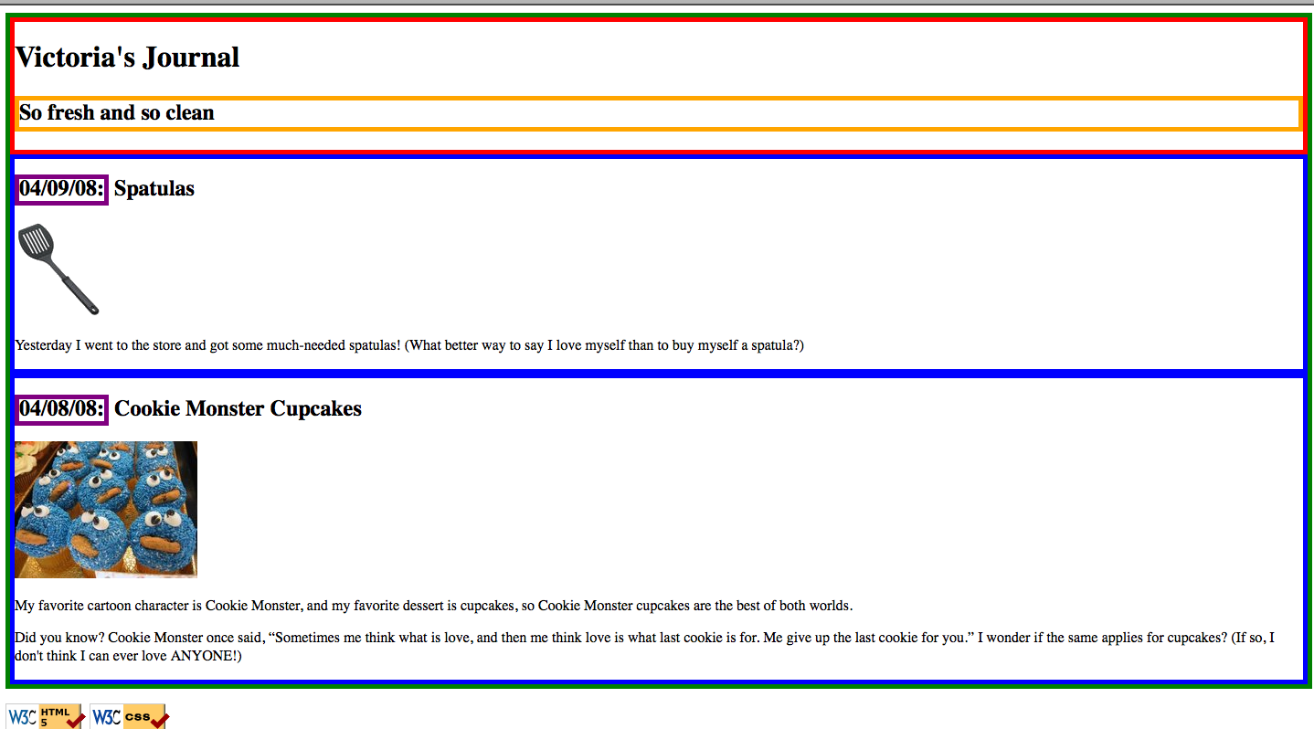
Exercise 1: output
After you are done, your page should look like this:
#container {
border: 5px green solid;
}

Slide 57
Exercise 2: Paddings, margins, Backgrounds
Add padding, margins, backgrounds to the page. Change only your layout.css.
The box with the green border should have a background color of white.
The box with the blue borders should have a background color of #E8FBFB
It should have a padding of 5px (on all sides) and margin of 10px only on the top of the box.
The overall page content should be centered on the page, should have left and right margin of 10%.
Add a background image of your own choice.

Slide 58
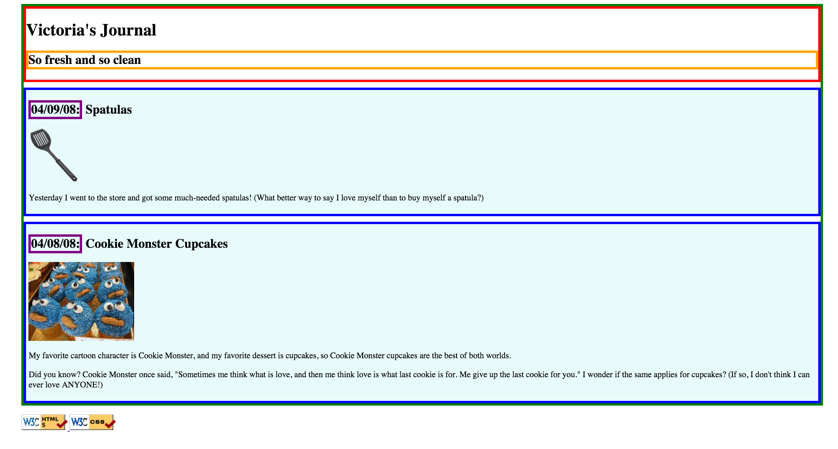
Exercise 2: Paddings, margins, Backgrounds

Slide 59
Exercise 3: Float, Align, Clear
Now, we will practice float, clear, and alignment. You may have to edit journal.html code as well as layout.css
The heading text in the red box should appear on the right side of the section page.
The text of each journal entry should be widened so that each line fills the entire width of the section. (justified).
The journal entry images should hover on the right side next to the surrounding text. The images should stay within the boundary of the blue box.
You can refer to this chapter for how to make float element fit:
http://www.webstepbook.com/samples/ch04-layout.pdf

Slide 60
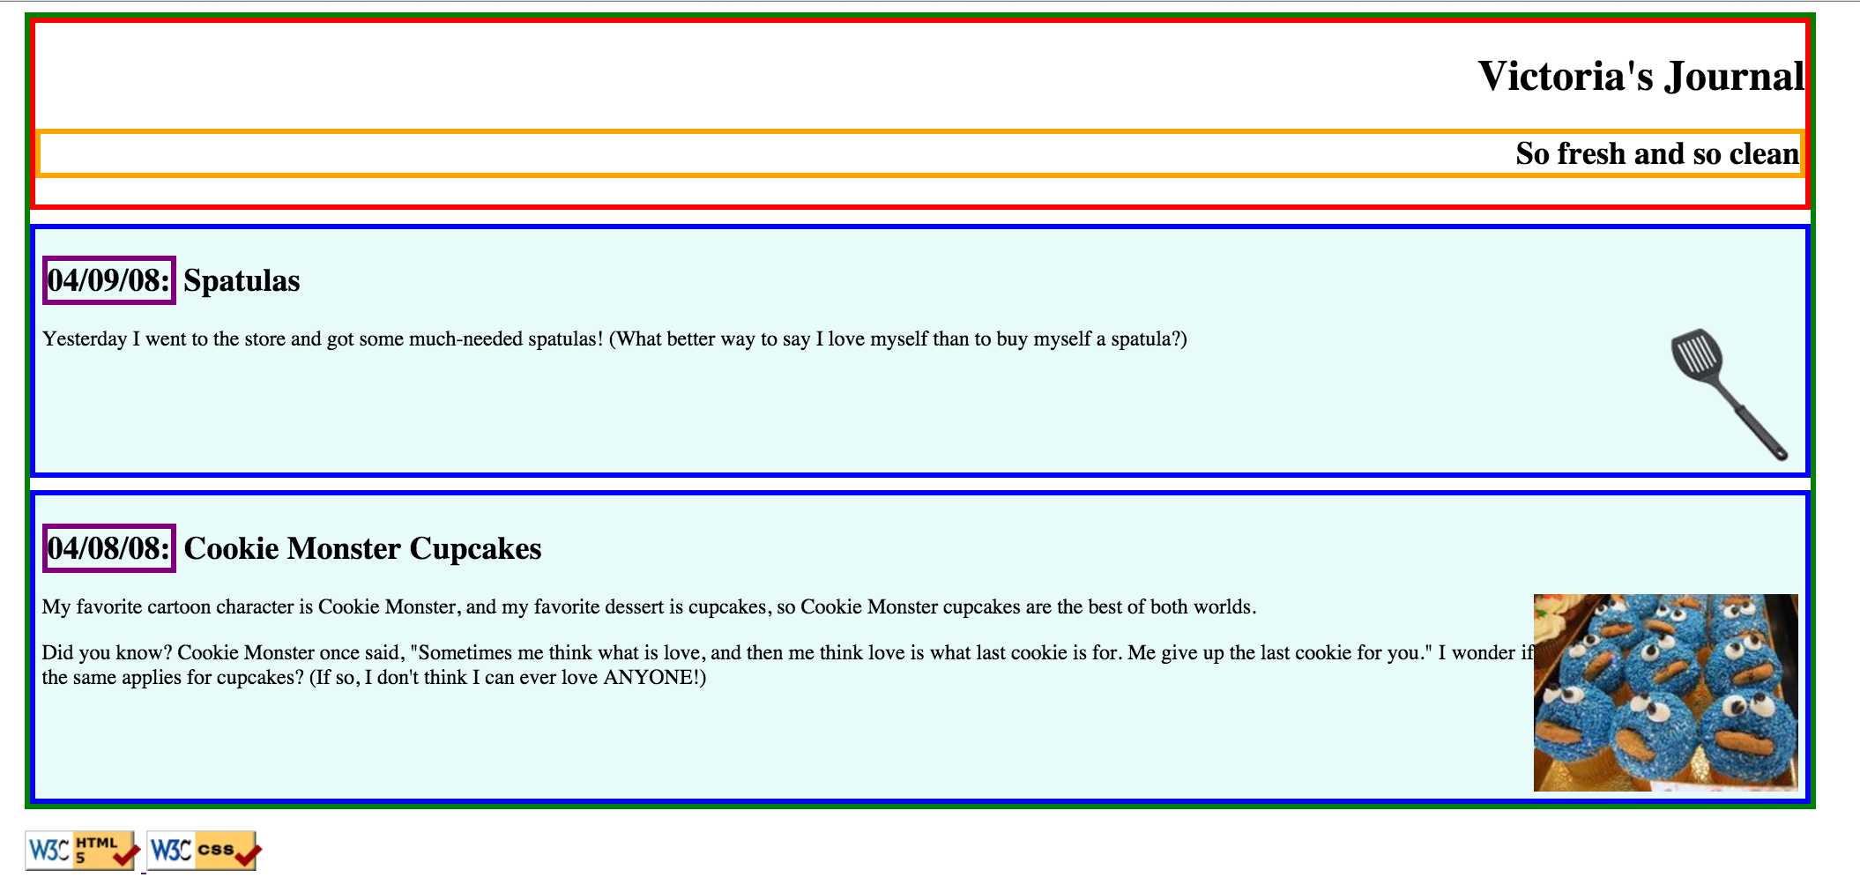
Exercise 3: output

Slide 61
Exercise 4: final touches
Change the box with green border to have a solid, white, 10px-thick border.
Change the boxes with the blue border to have a solid, 4px-thick border, in color #C239E9, with a 15px rounded border radius.
Chang the box with the purple border to have only a bottom border: blue, dashed, and 2px thick.
Change the box with the red border to have a background color of #A8F0F0, and get rid of its border.
Change the font size of the “So fresh and so clean” area to 14pt, and get rid of its border.

Slide 62
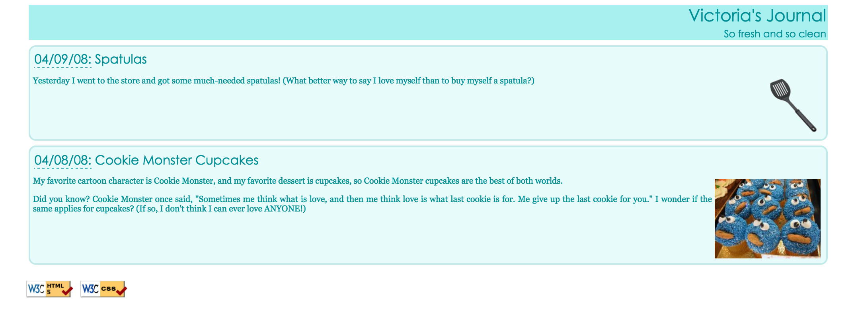
Exercise 4: output

Slide 63
Exercise 5 Extra : two columns, friend lists
Add a second column to the layout. Copy and paste the following code into journal.html:
<h1>Friends</h1>
<ul>
<li><a href="http://www.cs.washington.edu/154/">154 Buddies</a></li>
<li><a href="http://www.willsmith.net/">Big Will</a></li>
<li><a href="http://youtube.com/watch?v=mZHoHaAYHq8" title="Conan the Librarian">Conan the Librarian</a></li>
</ul>
Use the appropriate layout-related tags/attributes and CSS to make this list into a second, left-aligned column as shown below. The colors, borders, etc. of the list are not important; the focus is on the layout.
The layout with a second column must still be a “liquid” layout -- that is, all parts of it should adjust in size accordingly when the browser size changes.
Hint: When multiple elements float in the same direction, they arrange themselves into columns. Also see this chapter:
http://www.webstepbook.com/samples/ch04-layout.pdf

Slide 64
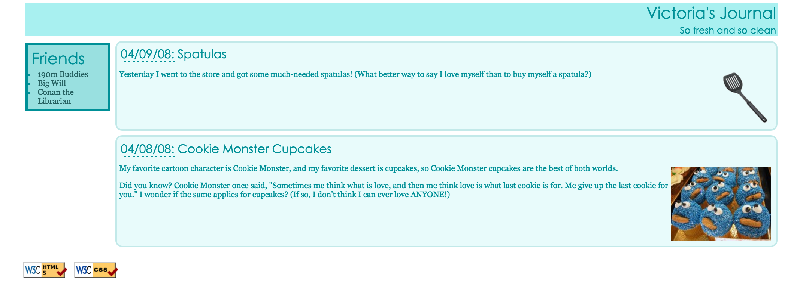
Exercise 5 : two columns, friend lists

Slide 65
Exercise 6 (extra) : Style more
Write your page so that if you hover over any element (i.e.. Any header, paragraph, image, etc) the element is highlighted in yellow.
This must be a one-selector, one-property addition to your stylesheet – no commas allowed! How can one rule apply to all elements? Google away.
Use CSS3 for rounded borders.
Use Google fonts links to use fancier font.
Use Flexbox to display various block elements (navigation bar).
Upload your webpage to a sever.

Slide 66
Next class
JavaScript Start
DOC model

Slide 67
Take-home reading and exercise
Reading on page layout:
http://www.webstepbook.com/samples/ch04-layout.pdf
DOC model:
https://developer.mozilla.org/en-US/docs/Web/API/Document_Object_Model/Introduction
JavaScript tutorial:
https://www.codecademy.com/learn/javascript

